Slide 1




Alcohol by Volumen (ABV)
Prediction Platform
Business Analytics & Insights
Max Causso - 301455365

Slide 2




Executive Summary
Objective
Business Value
Solution
Build an ABV (alcohol%) predictor to adjust recipes before brewing, reducing rework and label risk in Canada.
Fewer out-of-tolerance batches, faster releases, and protected excise margin.
Azure cloud architecture.
Test multiple algorithms and choose the best accuracy + stability + explainability.

Slide 3


Business context & Opportunity
Labelling
Canadian Food and Drug Regulations require the % alcohol declaration when ≥1.1% ABV.
Provincial tolerances:
Ontario (LCBO): Use LCBO’s “Actual vs Declared Alcohol Content – Guideline.”
Nova Scotia (NSLC): Explicit bands (e.g., 4.1–5.5% ABV: ±0.5% is adherence).
Operational risk & cost
Early ABV prediction reduces rework, relabeling, QC holds, and scrap, protecting margin and speeding releases.
Sources: CFIA – Labelling requirements for alcoholic beverages; LCBO QA – Actual vs Declared Alcohol Content – Guideline; NSLC – ABV Factsheet (Beer).

Slide 4
Approach overview
1
2
3
4
Data
Preparation
Feature
Selection
Model testing & evaluation
Deployment in Cloud
Compared linear (Full/Ridge), tree/ensemble, and NN
Balanced accuracy vs explainability.
Hold-out metrics (R², MAE).
Controlled overfitting.
Ridge kept as glass-box baseline.
Azure API + Power BI dashboard.
Versioned model & audit log.
Cleaned data, grouped styles.
Engineered OG−FG (attenuation) and ratios.

Slide 5
Model Comparison
Full Regression Companion (glass-box)
Random Forest
R² 0.995 - MAE 0.055% ABV
Captures non-linear recipe effects
Stable across styles and low CV variance
Use: Operational predictor (pre-brew)
R² 0.869
Use: Explainability/training, audits, coaching
Not used as the operational predictor

Slide 6
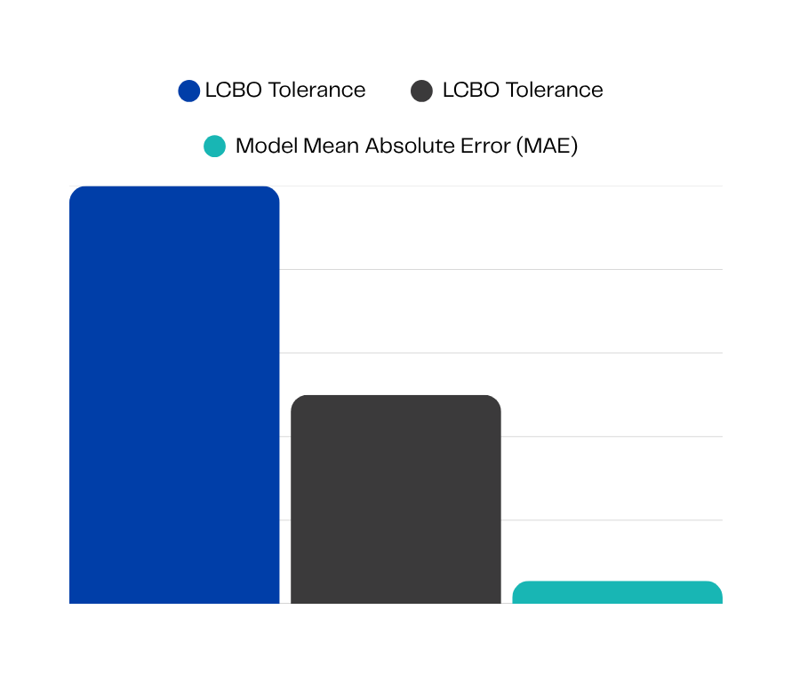
Final choice:
Random Forest
Accuracy with regulatory headroom
R² 0.995, MAE 0.055% ABV — ≈9× smaller than LCBO one-side tolerance (0.50) for beers <5.6% ABV.
Our solution
Lower label/compliance risk
Fewer lots near tolerance edges → fewer holds, retests, or relabels. Predictions versioned in Azure SQL for QA/audits.
% ABV (absolute)
Operational fit & speed
1%
0.50%
0.055%
Batch scoring in Python; ADF orchestration; Azure SQL serving; Power BI visibility. Minutes, not hours.
Beer > 5.6% ABV
Beer < 5.6% ABV
All types of beer
Sources: LCBO QA – Product Packaging Standards & Guidelines for Chemical Analysis (p. 52, “Actual vs Declared Alcohol Content – Guideline”); NSLC – ABV Factsheet (Beer).

Slide 7
Top drivers of ABV
Attenuation (OG − FG) dominates
Original Gravity (OG) sets the ceiling
Efficiency × OG (real‑world limiter)
Quick lever: yeast health/pitch, ferm temp/time, mash temp.
Direction: lower FG : ↑ABV; higher FG : ↓ABV (ABV ≈ 131.25 × ΔSG)
Quick lever: grain bill concentration, adjuncts, boil concentration.
Direction: higher OG: ↑ABV if FG doesn’t rise much (diminishing returns at high OG)
Quick lever: lauter performance, mill gap, mash schedule, sparge discipline.
Direction: better efficiency at target OG: ↑ABV; at extremes returns flatten

Slide 8

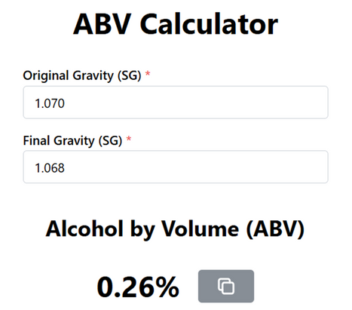

Real-life examples
How tweaks change ABV
Recipe level (OG & FG)
Compliance check (ON/NS)
+0.25% ABV → target −0.002 SG in FG (2 points).
−0.25% ABV → allow +0.002 SG in FG.
+0.6–1.3% ABV → raise OG by +0.005–0.010 SG and protect attenuation.
Compare to LCBO/NSLC band.
House guardrail: escalate to QA if margin ≤0.2% to nearest limit.
Example: 5.34% vs upper 5.50 → margin 0.16 → Escalate .
Sources: ABVCalculator.ca; CFIA — Labelling requirements for alcoholic beverages; LCBO QA — Product Packaging Standards & Guidelines for Chemical Analysis, p.52.

Slide 9
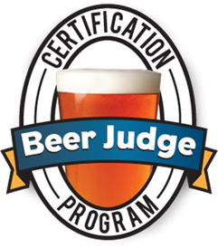
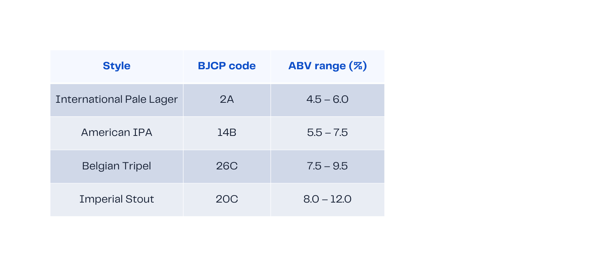
Pattern by beer style
ABV range
Use BJCP style ranges as QA guardrails
•Lag any predicted ABV that sits outside the style’s window before brewing. (e.g., many international lagers around ~4–5% ABV; styles like imperial stouts much higher — see per-style sheets.)
Sources: ABVCalculator.ca; CFIA — Labelling requirements for alcoholic beverages.

Slide 10


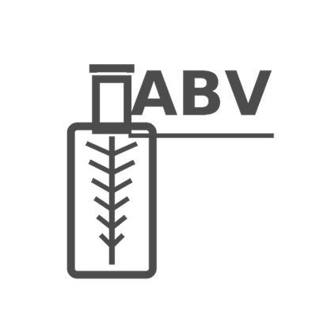
Cloud-based prediction platform
Inputs
Outputs
Integration
OG, expected FG (target attenuation), brewhouse efficiency, IBU, style.
Predicted ABV + confidence band + green/amber/red tolerance light.
Power BI dashboard for QA approvals.
Versioned model service.
Audit log of predictions.

Slide 11


Business value for breweries
Quality control — right‑first‑time
Variability reduction - stable FG, better yield
Compliance & margin protection
Pre‑brew flags using LCBO/NSLC guardrails
Fewer rework/hold decisions, faster QA sign‑off
Upstream ABV decisions (before wort is made)
Standardize pitch rate / O₂ / fermentation temperature.
Protect attenuation → tighter FG, less ABV drift.
Reduce over‑strength giveaway
On‑label across LCBO/NSLC; fewer relabel cycles
Excise risk: avoid crossing CRA tiers
Audit‑ready logs in Azure SQL & Power BI

Slide 12

Recommendations & Next steps
Adopt
Instrumentation
Random Forest: for day-to-day; keep Full (Ridge) Regression for explainability/audits.
Capture OG & FG per batch; correct for temperature; document yeast pitch rate, fermentation T°, and pH in a standard log.
Dashboards
Pilot
Add BJCP guardrails + province-specific tolerance lights (e.g., NSLC table; LCBO guideline page).
(30–60 days, 2 brands): KPIs = % batches out-of-tolerance, rework hours, days-to-release; scale on success.

Slide 13
Thanks

